Slide 1
ARCHITECT
Campus FoodShare
Platform
UML Modelling & Software Architecture
University Surplus Food Donation & Redistribution Platform — Design Documentation and Technical Specification
FSE Coursework 2 | June 2026
Zong Ji
M0507732R
1

Slide 2
Executive Overview
01
02
03
Introduction & UML Modelling
Software Architecture Design
Design Justification & QA
■ Project scope and stakeholder overview
■ Use case diagram with 4 actor groups
■ Class diagram with 4 domain entities
■ Full traceability to CW1 requirements
■ Layered N-Tier architecture with MVC
■ System architecture block diagram
■ Component roles and communication
■ Unit test cases for all domain classes
■ Key design trade-off analysis
■ Three-tier testing strategy
■ Limitations and future improvements
■ CW1 requirements alignment
2

Slide 3
01
Introduction & UML Modelling
Project scope, stakeholder alignment, and UML diagram specifications
3

Slide 4
Campus FoodShare connects donors, recipients, and administrators across campus
Platform Overview
3
8
Campus FoodShare is a university surplus food donation and redistribution platform designed to reduce campus food waste while supporting food-insecure students and staff.
The platform enables food donors (cafeterias, event organizers) to list surplus items, recipients to browse and claim donations, and administrators to moderate content and manage users.
Core Stakeholder Groups
Functional Use Cases
CW2 Deliverables
■ UML use case and class diagrams
■ Software architecture design and evaluation
■ Unit test cases and version control plan
Core Platform Workflows
Listing Creation
Claim Management
Moderation
Notifications
Donors create food listings with quantity, collection time window, and location. Listings automatically expire after the collection window closes.
Recipients browse active listings and submit claims. Each listing can only have one active claim to ensure fair distribution.
Users report inappropriate listings. Admins review reports and take action. The system sends notifications for all key events.
Automated alerts for claim status changes, listing expirations, and moderation updates keep all stakeholders informed.
4

Slide 5
Use case diagram captures four core actor groups with 8 functional use cases
Actor Groups
Use Case to Requirement Traceability
Donor
Use Case | Description | Primary Actor | CW1 Ref
UC-01 Create Listing | Donor posts surplus food with details | Donor | FR-001
UC-02 Browse Listings | Recipient views available donations | Recipient | FR-002
UC-03 Submit Claim | Recipient reserves a food listing | Recipient | FR-003
UC-04 Manage Claim | Donor accepts/rejects claim | Donor | FR-004
UC-05 Report Listing | User flags inappropriate content | Any User | FR-005
UC-06 Moderate Report | Admin reviews and takes action | Administrator | FR-006
UC-07 Send Notification | System alerts on status changes | System | FR-007
UC-08 Handle Expiry | Auto-expire past listings | System | FR-008
■ Create food listings
■ Manage donation history
■ Receive claim notifications
Recipient
■ Browse active listings
■ Submit claims
■ Track claim status
Administrator
■ Moderate reports
■ Manage user accounts
■ Review platform analytics
System
■ Send notifications
■ Handle listing expiry
■ Automated status updates
5

Slide 6
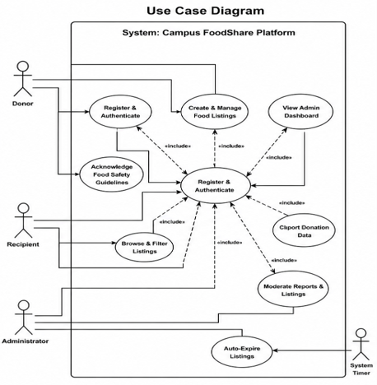
Case diagram
6

Slide 7
Class diagram models four domain entities with full attributes and relationships
User
FoodListing
Attributes:
- userId: UUID (PK)
- email: String (unique)
- passwordHash: String (bcrypt)
- role: Enum [DONOR, RECIPIENT, ADMIN]
Attributes:
- listingId: UUID (PK)
- donorId: UUID (FK → User)
- quantityKg: Double
- status: Enum [ACTIVE, CLAIMED, EXPIRED]
Methods:
+ authenticate(email, password): Session
+ updateProfile(data): User
+ validatePassword(password): Boolean
Methods:
+ create(donorId, data): FoodListing
+ validate(): ValidationResult
+ expire(): void
Claim
ModerationReport
Attributes:
- claimId: UUID (PK)
- listingId: UUID (FK → FoodListing)
- recipientId: UUID (FK → User)
- status: Enum [PENDING, COMPLETED, CANCELLED]
Attributes:
- reportId: UUID (PK)
- reporterId: UUID (FK → User)
- targetListingId: UUID (FK → FoodListing)
- reason: String (max 500 chars)
Methods:
+ submit(recipientId, listingId): Claim
+ complete(): void
+ cancel(): void
Methods:
+ submit(reporterId, listingId, reason): Report
+ resolve(action): void
+ validate(): ValidationResult
7

Slide 8
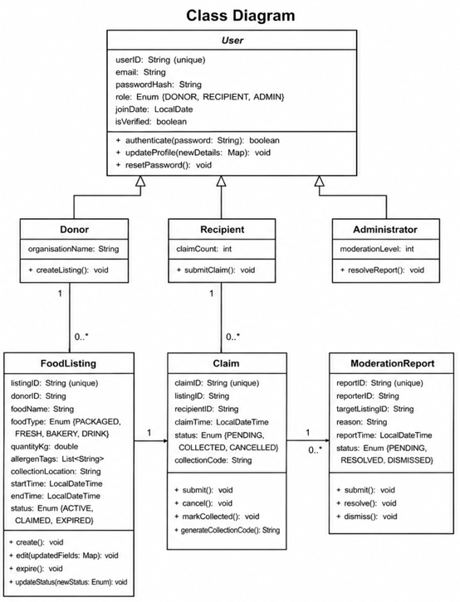
Class diagram
8

Slide 9
02
Software Architecture Design
Layered architecture selection, system component design, and unit testing strategy
9

Slide 10
Layered N-Tier architecture with MVC pattern selected for maintainability and testability
3-Layer
<2s
MVC
Clear separation of concerns with Presentation, Business Logic, and Data Access layers
Target page load time for 300 concurrent users per NFR-001
Model-View-Controller pattern in Presentation Layer for UI separation
Layer Structure & Responsibilities
1
Presentation Layer
2
Business Logic Layer
3
Data Access Layer
Responsibilities:
■ User interface rendering
■ Input validation
■ Request routing
Pattern: MVC
Controllers handle HTTP requests, delegate to business services, and render views. Views are decoupled from business logic.
Responsibilities:
■ Domain rules enforcement
■ Workflow orchestration
■ Core system functionality
Key Services:
ListingService, ClaimService, UserService, NotificationService, and ModerationService.
Responsibilities:
■ Database abstraction
■ Repository interfaces
■ External API wrappers
Pattern: Repository
Business layer has zero knowledge of underlying database technology. All data access via well-defined interfaces.
10

Slide 11
System architecture defines clear layer communication via REST APIs and repository interfaces
Presentation Layer
Component Communication
■ View Components (UI)
■ Controllers (Request Handling)
■ Input Validation
■ Session Management
REST API over HTTPS
Presentation ↔ Business Layer
■ Protocol: REST API over HTTPS
■ Pattern: Controllers validate input and delegate business operations to services
■ Data format: JSON request/response bodies
■ Security: Authentication tokens, input sanitization
Business ↔ Data Layer
Business Logic Layer
■ Pattern: Repository interfaces (Dependency Inversion)
■ Key principle: Business layer has no knowledge of underlying database technology
■ Benefit: Easy to swap database implementations for testing
■ Transaction: Unit of Work pattern for atomic operations
■ Domain Services
■ Business Rules Engine
■ Workflow Management
■ DTO Mapping
Repository Interfaces
External Services Integration
■ Approach: Official APIs only, with wrapper classes in data layer
■ Purpose: Isolate third-party dependencies from business logic
■ Services: Email/SMS notifications, campus SSO (future)
■ Resilience: Circuit breaker pattern for external failures
Data Access Layer
Repositories | Database | External APIs
11

Slide 12
Unit test suite covers 4 domain classes with 12 test cases across all scenarios
12
4
3
≥85%
Total Test Cases
Domain Classes Tested
Scenario Types per Class
Target Code Coverage
Unit Test Case Summary
Class | Type | Scenario | Expected Result | Status
User | Normal | Valid credentials login | Auth succeeds, session returned | Pass
User | Edge | Max-length password (72 chars) | Hash verified correctly | Pass
User | Error | Unregistered email login | Generic error, no info disclosed | Pass
FoodListing | Normal | Create valid active listing | ACTIVE status, appears in browse | Pass
FoodListing | Edge | Create listing with zero quantity | Rejected: "quantity > 0" error | Pass
FoodListing | Error | Create with past end time | Fails: "end time must be future" | Pass
Claim | Normal | Submit claim for active listing | PENDING status, listing CLAIMED | Pass
Claim | Edge | Claim exactly at expiry time | Rejected, listing marked EXPIRED | Pass
Claim | Error | Claim already reserved listing | Fails: "already reserved" error | Pass
ModerationReport | Normal | Submit valid report | PENDING status, added to queue | Pass
ModerationReport | Edge | Report with max-length reason (500) | Submitted, full text stored | Pass
ModerationReport | Error | Report non-existent listing | Fails: "listing not found" error | Pass
12

Slide 13
03
Design Justification & Quality Assurance
Design trade-off analysis, requirements traceability, testing strategy, and future roadmap
13

Slide 14
Three key design trade-offs balance simplicity, ethics, and operational feasibility
CW1 Requirements Traceability
1
Layered Monolith over Microservices
CW1 Deliverable | CW2 Mapping | Status
Functional Requirements | Use Case Diagram (UC-01 to UC-08) | Complete
Domain Entities | Class Diagram (4 classes) | Complete
NFRs (Performance, Security) | Architecture Design | Complete
Stakeholder Requirements | Unit Tests + Architecture | Complete
Decision: Single monolithic application with 3-layer architecture
Rationale: Microservices introduce unnecessary operational complexity for a single-campus prototype with a small development team.
Impact: Simplified deployment, easier testing, lower infrastructure overhead.
2
Manual Logging over AI Recognition
Decision: Donors manually input food item details
Rationale: AI image recognition for food items is explicitly out of scope per CW1 boundaries. Manual input prioritises simplicity and reliability.
Impact: Achievable scope, no ML model training required, consistent data quality.
Key Design Principle
Every use case in the UML diagram maps directly to a functional requirement from CW1, and every class in the class diagram is derived from domain entities described in the stakeholder and requirements sections.
No features outside the defined in-scope items have been introduced in the design phase.
3
Minimal Data over Rich Profiling
Decision: Limited personal data collection to protect recipient privacy
Rationale: Prioritises ethical requirements and GDPR compliance over administrative convenience of richer user data.
14

Slide 15
Three-tier testing strategy ensures comprehensive quality assurance from unit to acceptance
Tier 1
Tier 2
Tier 3
Unit Testing
Integration Testing
Acceptance Testing
Scope:
All domain class methods tested with three scenario types:
■ Normal cases (expected behavior)
■ Edge cases (boundary values)
■ Error cases (exceptions)
Target: ≥85% coverage
Scope:
Validates interactions between architectural layers:
■ API Controller → Business Service
■ Business Service → Repository
■ Data persistence round-trips
Focus: Layer contracts
Scope:
End-to-end verification against CW1 acceptance criteria:
■ Each functional requirement tested
■ User journey validation
■ Cross-browser compatibility
Focus: Requirement compliance
Testing Metrics & Coverage Targets
≥85%
12
3
100%
Code coverage target for core business logic
Unit test cases covering all domain classes
Scenario types: Normal, Edge, Error
CW1 functional requirement coverage
15

Slide 16
Monolithic design supports migration path to microservices for multi-campus expansion
Current Limitations
Future Improvement Roadmap
Single-Campus Constraint
Phase 1: Microservices Migration
The monolithic architecture is designed for a single campus deployment. Scaling to multiple campuses would require significant architectural changes including service decomposition.
Decompose monolith into independently deployable services (Listing Service, Claim Service, User Service, Notification Service) to support multi-campus scaling.
Non-Functional Testing Gap
Phase 2: Non-Functional Testing
Load testing, security penetration testing, and accessibility auditing are required before production deployment. These are excluded from the prototype scope.
Implement comprehensive load testing (300 concurrent users), security penetration testing, WCAG 2.1 accessibility auditing, and performance benchmarking.
Phase 3: Campus SSO Integration
No Campus SSO Integration
Integrate with campus identity provider via OAuth 2.0 / SAML for seamless single-sign-on, improving user onboarding and security posture.
Integration with campus single-sign-on (SSO) would improve user onboarding but was excluded from the initial prototype scope to keep the project achievable within semester constraints.
Phase 4: AI-Enhanced Features (Optional)
Food image recognition for automated listing categorisation and quality assessment.
16

Slide 17
References
Thank You
1. Martin, R. C. (2018). Clean Architecture: A Craftsman's Guide to Software Structure and Design. Prentice Hall.
2. Fowler, M. (2002). Patterns of Enterprise Application Architecture. Addison-Wesley.
3. Myers, G. J., Sandler, C., & Badgett, T. (2011). The Art of Software Testing (3rd ed.). Wiley.
Campus FoodShare — UML Modelling & Software Architecture
FSE Coursework 2
Deliverables Summary
■ UML Use Case & Class Diagrams
■ Layered Architecture Design with MVC Pattern
■ 12 Unit Test Cases (4 Domain Classes)
■ Three-Tier Testing Strategy & Version Control Plan
17

